Slide 1
Customize Your Future: CoverCraft
Team members:
Zhifei Li
Jiale Lyu

Slide 2
CONTENTS
Website Features
Benefits of Customize Your Future
Get Started with Customize Your Future
Thank You!

Slide 3
Website Features
01

Slide 4
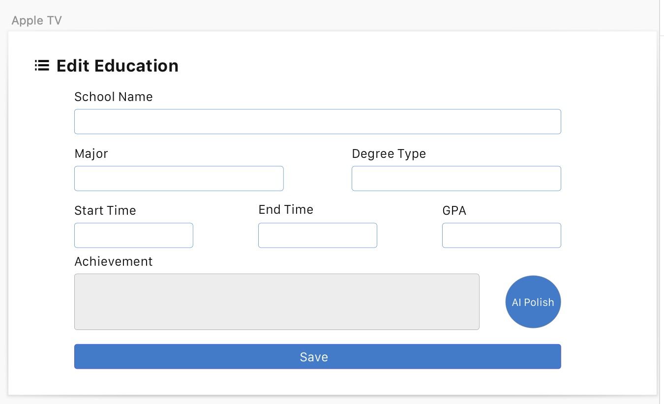
Website Features
Input Personal Information with Polishing Service: Enter your project experience or work experience and utilize our ChatGPT API-powered polishing service. Compare the original text with the polished version and choose the most satisfying result.

Slide 5
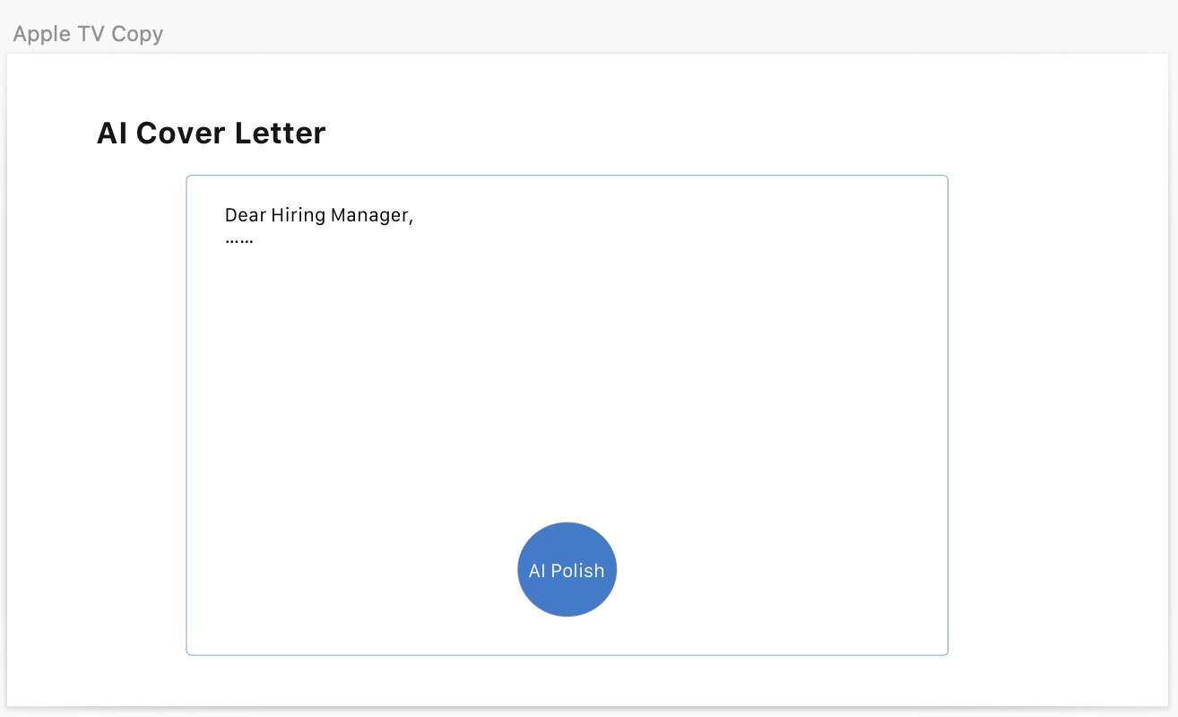
Website Features
Customized Cover Letter Creation: Generate a tailored cover letter based on your personal information and job description. Emphasize specific keywords to make your cover letter more distinctive and impactful.

Slide 6
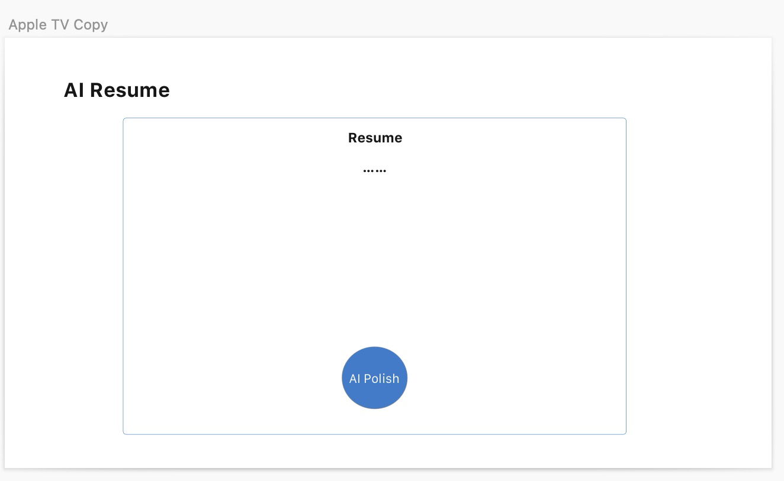
Website Features
Resume Reference and Variations: Access a variety of resume templates and formats. Upload your personal information to create attractive and standout resumes. Choose from different resume references to suit your style.

Slide 7
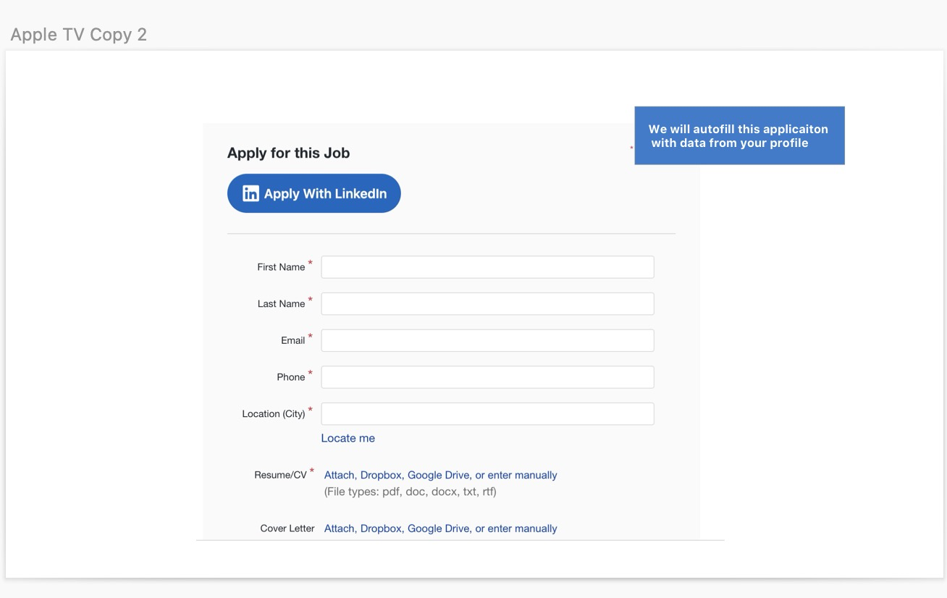
Website Features
Auto-Fill Chrome Extension: Streamline your job application process with our convenient Chrome extension. Click a button to automatically fill repetitive content in job applications, saving you time and effort.

Slide 8
Benefits of Customize Your Future
02

Slide 9
Benefits of Customize Your Future
RSA data encryption
Security: RSA algorithm is based on the difficult problem of number theory, so it has high security.
High efficiency: The encryption speed of the RSA algorithm is fast, and the decryption speed is also fast, and can meet the actual needs of most applications.
Openness: The RSA algorithm is an open algorithm, and the code and documents are publicly available, which facilitates research and improvement.
Ease of implementation: The implementation of the RSA algorithm is simple and easy, and can be implemented on different platforms.

Slide 10
Benefits of Customize Your Future
Personalized Cover Letters: Create customized cover letters that showcase your skills and qualifications for each job application.
Impressive Resumes: Stand out from the competition with professionally designed resumes that highlight your experience and achievements.
Efficient Application Process: Automate the filling of repetitive content in job applications, making the application process faster and more efficient.

Slide 11
Get Started with Customize Your Future
03

Slide 12
Get Started with Customize Your Future
Visit our website at [www.customizeyourfuture.com](http://www.customizeyourfuture.com) and take your job search to the next level.

Slide 13
Thank You!
04

Slide 14
Thank You!
Connect with us on social media for the latest updates and job search tips.
Customize Your Future: Your Path to Personalized Job Applications

Slide 15
Connect with us on social media for the latest updates and job search tips.
LinkedIn:
https://www.linkedincom/in/zhifei-li-288108250
https://www.linkedin.com/in/jiale-lyu-065b72243/

Slide 16
THE END
THANKS

